Slide 1
Welcome!

Slide 2
Thank you to our sponsors!
ASU Online - EdPlus
ASU University Technology Office (UTO)
Civitas Learning
Notes:
Athena - Welcome and Thank you! - 30 seconds

Slide 3
Session Agenda
Welcome
Introduction
Guest Presenter
Dr. Jess Alberts
Notes:
Gemma - 30 seconds

Slide 4
Welcome!
Notes:
Athena

Slide 5
About EdTech Women
About ETW
PHX ETW
Membership
Meetings
Notes:
Athena

Slide 6
Our Mission
a networked community for women's leadership in education technology
business experts, technologists, designers, and educators
development of women's leadership opportunity in education technology
build connections and skills that lead to stronger businesses, better products, and different schools
create a community -- local, national, international, and digital levels
committed to support and innovation -- driven to make change
inclusivity, visibility, and impact

Slide 7
Dr. Jess Alberts
Notes:
Athena

Slide 8
Negotiating for What You Want
Jess Alberts, Ph.D.

Slide 9
Steps to Successful Negotiations
Decide to Negotiate
Generate a list of issues to negotiate
Develop a negotiation plan
Know your goals and interests
Manage Your Emotions
Use effective strategies for engaging the other party

Slide 10
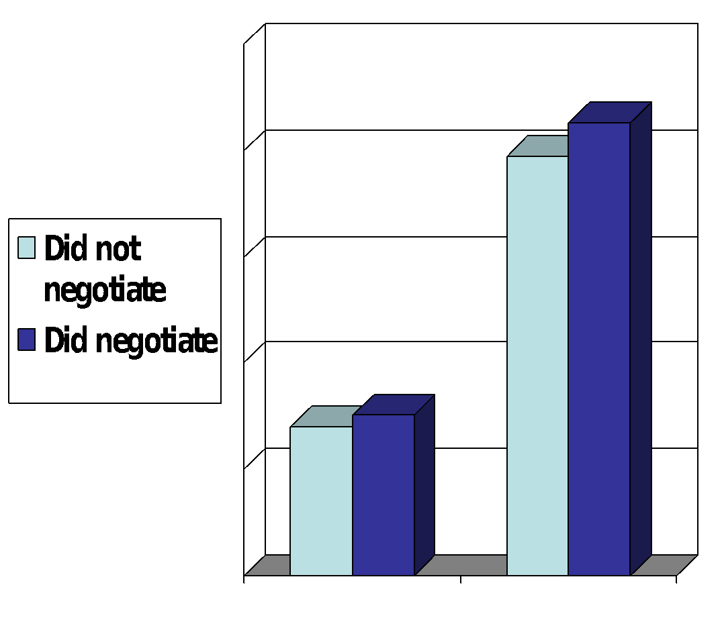
Decide to Negotiate
$361,172 Difference in Earnings Over Career
$70,000 $75,000

Slide 11
Decide the Issues to Negotiate
Car
Price
Value of trade-in
Features
Warranty
Interest rate
New Job
Salary
Paid time off
Relocation Costs
Educational/Training Benefits
Hours

Slide 12
Prepare the Negotiation Plan
Create Your Best-Case Scenario
Create Your Fall Back Position
Create a BATNA
Decide on Your Walk Away Point

Slide 13
Create Your Best Case Scenario
Your ideal – but realistic – outcome
Set an optimistic, justifiable target
Be specific – write this in your negotiation plan
EXAMPLE: Car
Cost: $26,000
Trade-in: $12,000
Features: Blind spot monitor, lane assist, forward
collision warning
Warranty: 5 year unlimited
Interest rate: 3%

Slide 14
Develop Your Fall Back Position
Ok deal – would make you happy
It’s important this a deal that satisfies you
EXAMPLE:
Cost: $27,500
Trade-in: $10,000
Features: Blind spot monitor, forward collision warning
Warranty: 5 year unlimited
Interest rate: 5%

Slide 15
Develop Your Best Alternative to a Negotiated Agreement
If an agreement cannot be reached, what options do you have?
The stronger your BATNA, the more powerful you will feel and act
Best Alternatives to A Negotiated Agreement
Try another dealership
Use an intermediary negotiator
Drive the car you already have
Look for another car you would like & could a better deal on
Try again later

Slide 16
Decide Your Walkaway Point
Decide in Advance the Point at which You will Walk away.
Some deals are not worth making.
However, you can get caught up in the moment or your desire for a deal
So you accept a deal you later regret

Slide 17
Goals vs Interests
Goal: what you want
Interest: why you want what you want
Example:
I want a raise (goal)
I want parity/fairness; to be rewarded for additional responsibilities I perform; to feel valued for my contributions (interests)
FOCUS ON INTERESTS

Slide 18
Manage Your Emotions
Moods & attitudes play a more powerful role in influencing other parties than
does the persuasiveness of your arguments.
Critical Moods & Attitudes can (and do) Trigger Defensiveness
Which can prevent even a good deal from occurring

Slide 19
Engaging the Other Party
Look for common ground
How might it serve the other party to help you
achieve your goals?
What are the other party’s interests?
Why might the other person say no?
Budget, policy, equity/fairness
Provide a rationale/story for why you deserve what you are asking for

Slide 20
Thank you for being here!
The meeting was great because YOU attended!
Next Meeting:
July 2019
Bring colleagues and friends!
Notes:
Gemma

