Slide 1
PDF Accessibility
An Introduction

Slide 2
Objectives
By the end of this session, you will be able to:
Identify strategies for determining if a PDF is accessible.
Recognize the steps to run the Accessibility Full Check in Adobe Acrobat.
Recognize the steps to remediate flagged issues in Acrobat.
Recall strategies for creating accessible PDFs.
Identify resources where you can find help.
Notes:
In addition, I’d like to give you a moment to think about your own goals and objectives related to this topic. We will have a Q&A session at the end, and we’d be happy to answer your questions or to get you to the right resources.

Slide 3
How can I tell if my PDF is accessible?
Notes:
Imagine you’re asked to teach a course of 100 or more students. You find that you have students in the United States as well as students overseas. Some are learning English and aren’t yet fluent. Some students are in their late teens and early 20s, and some are in their 30s and 40s. Some of your students are majoring in your discipline, but some are majoring in something quite different. On top of this, some may have a cognitive or physical impairment.
How do you make sure this incredibly diverse group can be successful in this course?

Slide 4
You Have an “Ally” in Web Accessibility!
Notes:
Adero and Julie
Give a really brief overview of Ally. What is does and how it works for both faculty and students.

Slide 5
How Ally works
In the files of your course, an indicator is color-coded and uses a gauge to indicate the accessibility score of each item:
Red gauge with a left pointing arrow = low accessibility score
Yellow gauge with an upward pointing arrow = medium accessibility score
Green gauge with a right pointing arrow = high accessibility score
Notes:
Ally Gives You Simple Feedback to Help You Make Your Content Accessible to Everyone
Ally integrates directly with Canvas and provides feedback within your course workflow. Next to your course files and content, you can find small speedometers designed to display the levels of accessibility that your documents have reached. Click the indicator to view your accessibility feedback, and follow along step-by-step to make your content accessible to all.
These indicators are only visible to Canvas users with a Teacher or Administrator role in your course.

Slide 6
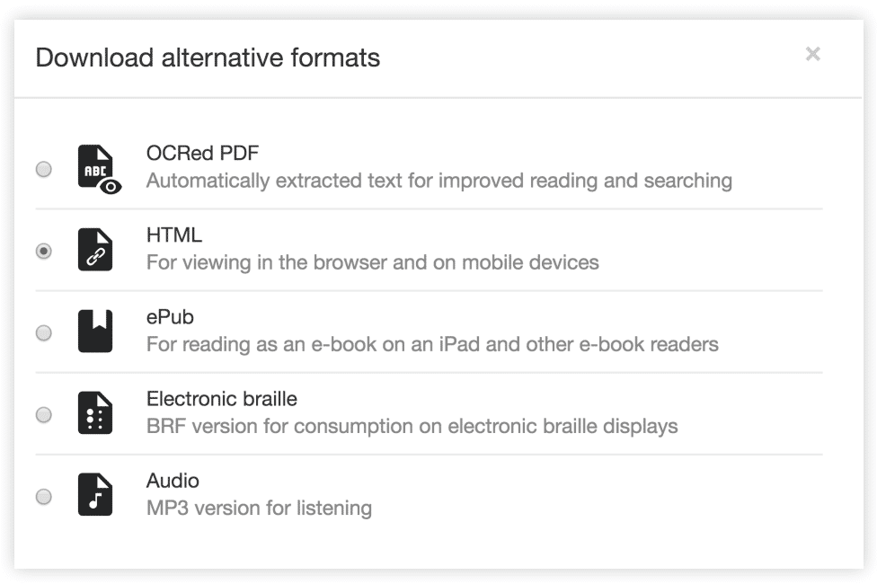
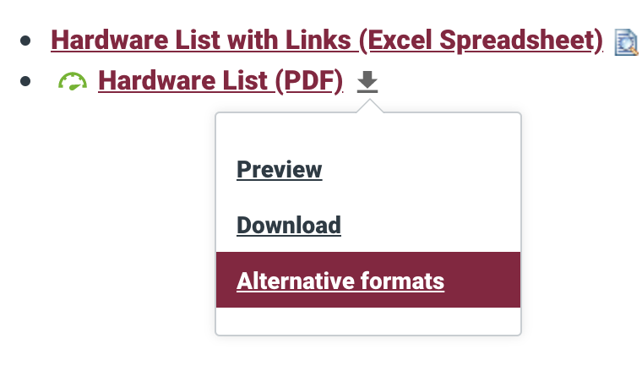
Benefits of using Ally
OCRed PDF Available
Notes:
Benefits for Students:
Ally improves the student experience by providing alternative and accessible formats of uploaded course documents. The accessible versions available will depend on the original document. Students may select the format that best meets their needs. Providing access to course documents in alternative formats is beneficial to all students, regardless of ability.
OCR = optical character recognition, available in some versions of Adobe product, which allow for PDF editing

Slide 7
Ally Training:
lms.asu.edu

Slide 8
Where Should I Start?
Run Accessibility Full Check in Acrobat Pro
Right click failed items to fix
Save and upload to Canvas

Slide 9
Demo
Notes:
Julie
Open Word doc and run through it. Pull up Canvas course and demo heading styles.

Slide 10
Upload Clean High Quality PDFs
Notes:
We often scan PDFs to share. Some things to avoid …

Slide 11
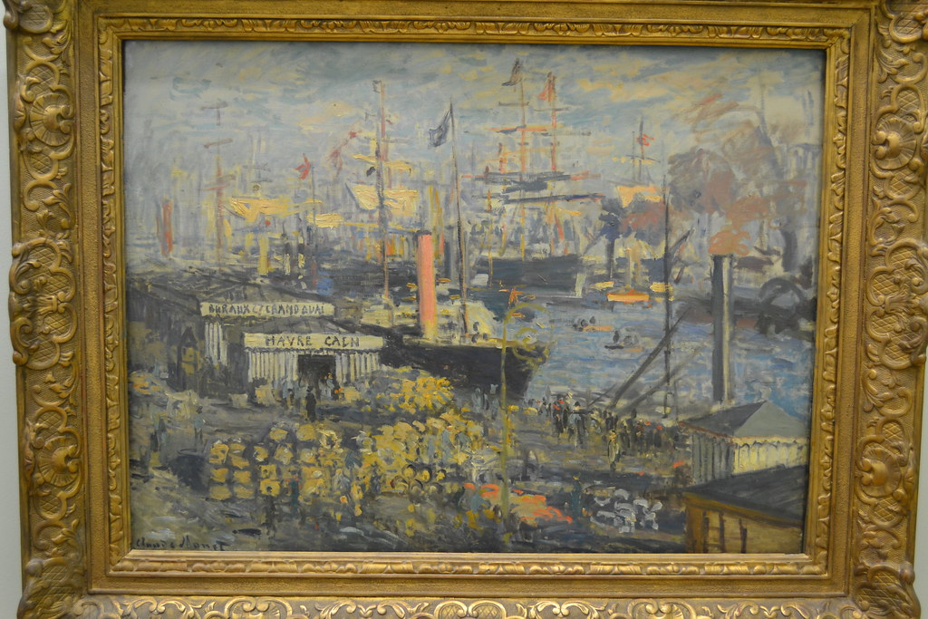
"The Grand Quai at Havre - Claude Monet 1874“ by larrywkoester is licensed under CC BY 2.0

Slide 12
Alt Text Should be Meaningful
Art Class
Framing Class
The Grand Quai at Havre by Claude Monet. This painting is in the impressionists style with muted colors and visible brush strokes that add to the sense of movement of wind in ships sails.
An oil painting in an ornately carved gold frame. The texture on the outer border is bold while the edge closest to the painting is more delicate.

Slide 13
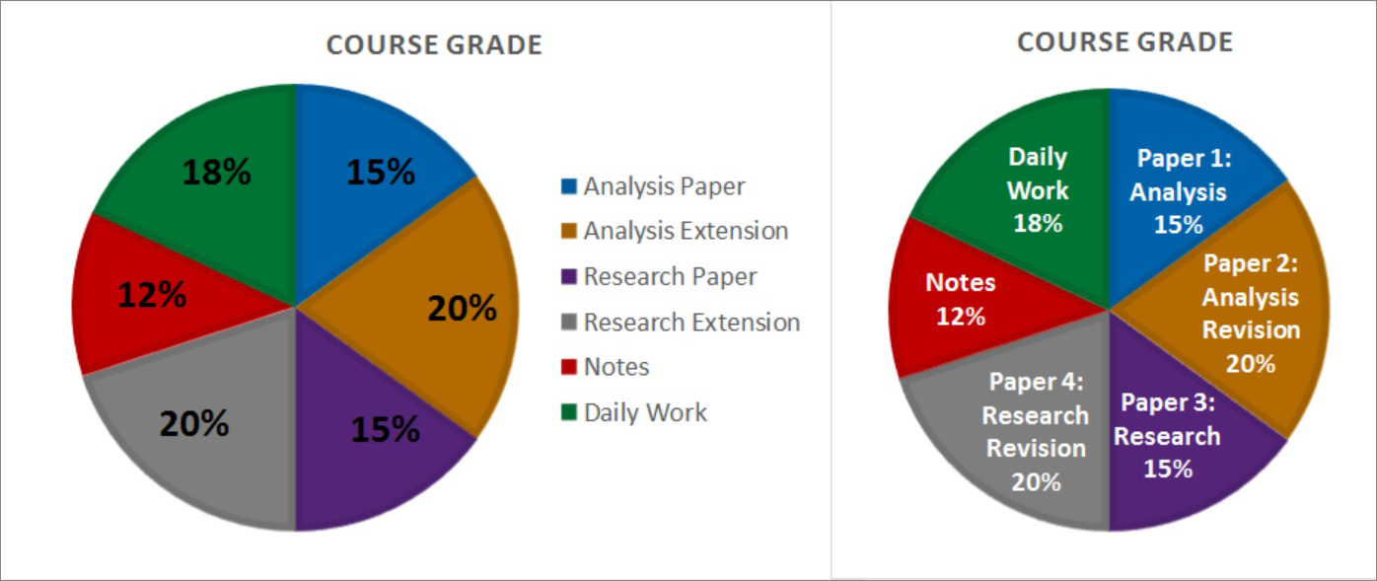
Using Color in Document Design
Color is often used to convey information but not everyone benefits.
Notes:
You do not need to avoid the use of color but you should be conscious of how you use color. Provide multiple means of receiving the information.

Slide 14
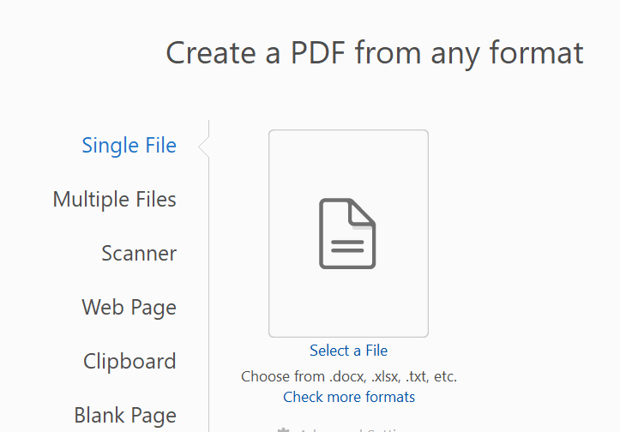
Follow Best Practices
Build your document using tool accessibility
Heading Hierarchy
AltText for images
Color not used as only indicator of meaning
San Serif font like Arial

Slide 15
UTO Access Clinic

Slide 16
Questions?

Slide 17
References
Griffin, E. (2019, June 3). Who uses closed captions? Not just the deaf or hard of hearing. 3PlayMedia. Retrieved from https://www.3playmedia.com/2015/08/28/who-uses-closed-captions-not-just-the-deaf-or-hard-of-hearing/.
National Disability Authority. (2014). What is universal design? Centre for Excellence in Universal Design. Retrieved from http://universaldesign.ie/What-is-Universal-Design/.

