Slide 1
Inclusive Design for International Populations
May 22, 2018

Slide 2
Educational Problems
“What should a sustainable alumni strategy for international scholarship recipients look like?”
“Emirati youth in public school aren’t ready for higher education upon graduation.”
Notes:
Are there other milestone categories – Communication, Content, Mentorship, Community Managers – maybe incentives?

Slide 3
Value of Inclusive Design
Design is an iterative process
Potential solutions are first conceived in broad strokes, emphasizing core functionality. After the ‘big ideas’ are identified, refined & validated, specific user experience challenges can be addressed, before turning attention toward details and edge-cases. At each level, the design is repeatedly evaluated and refined.
Design
Learn
Evaluate
Notes:
Reminder of our year of research concluded what Scholars wanted out of Baobab

Slide 4
Mastercard Foundation Case Study
Notes:
Are there other milestone categories – Communication, Content, Mentorship, Community Managers – maybe incentives?

Slide 5
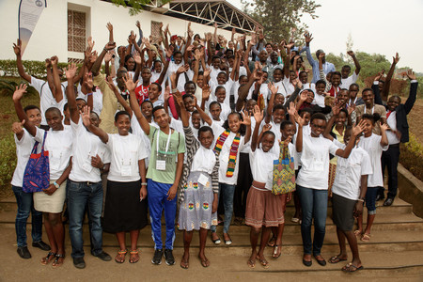
Mastercard Foundation Scholars
By 2023, The MasterCard Foundation will enable 30,000 Scholars to study around the globe on full-ride secondary or tertiary scholarships.
Notes:
Reminder of our year of research concluded what Scholars wanted out of Baobab

Slide 6
Vision
To unite this community of Scholars, ASU is developing a social learning network that will link MasterCard Foundation Scholars with tools, resources and relationships that will support and equip them to build upon their scholarship experiences and achieve impact across sub-Saharan Africa.
Notes:
Reminder of our year of research concluded what Scholars wanted out of Baobab

Slide 7
Barriers to Engagement
Limited access to technology and data
Limited time due to the work required for their scholarship
Notes:
Reminder of our year of research concluded what Scholars wanted out of Baobab

Slide 8
Primary Motivators
Need for mentorship specific to the continent
Worry about what the future held for them
Desire for support from individuals like them
Notes:
Reminder of our year of research concluded what Scholars wanted out of Baobab

Slide 9
Feed
Feed
The feed is a collection of all of the posts on the platform. Scholars can ask questions, tell stories and share their findings on the feed.
Scholars can stay up-to-date with their community, find inspiration and learn from mentors and other Scholars on Baobab.
Notes:
They contribute to the communities learning

Slide 10
My Baobab
Featured posts
A way for the Baobab team to promote content to Scholars.
Here they can feature different posts, Ask Me Anything sessions with mentors, new lessons, challenges and contests, opportunities and more!
Notes:
Designed custom interface and content with lightweight code to improve performance for users low-bandwidth infrastructure in Africa.

Slide 11
Feed
Ask Me Anything
Baobab mentors and other professionals host Ask Me Anything sessions where Scholars can ask questions that will be answered by the mentor.
“I love the AMA sessions, very educative, it gives me the opportunity to get real-time answers from experienced professionals and most times I just want to tag everyone to participate or read other's perspectives.” – Mastercard Foundation Scholar

Slide 12
Learning
Lessons
Scholars can take any of the 30+ lessons available on Baobab on topics such as emotional intelligence, design thinking and writing resumes.
Completing lessons will unlock badges that track your progress towards developing leadership skills.
Notes:
Content uses examples from Africa

Slide 13
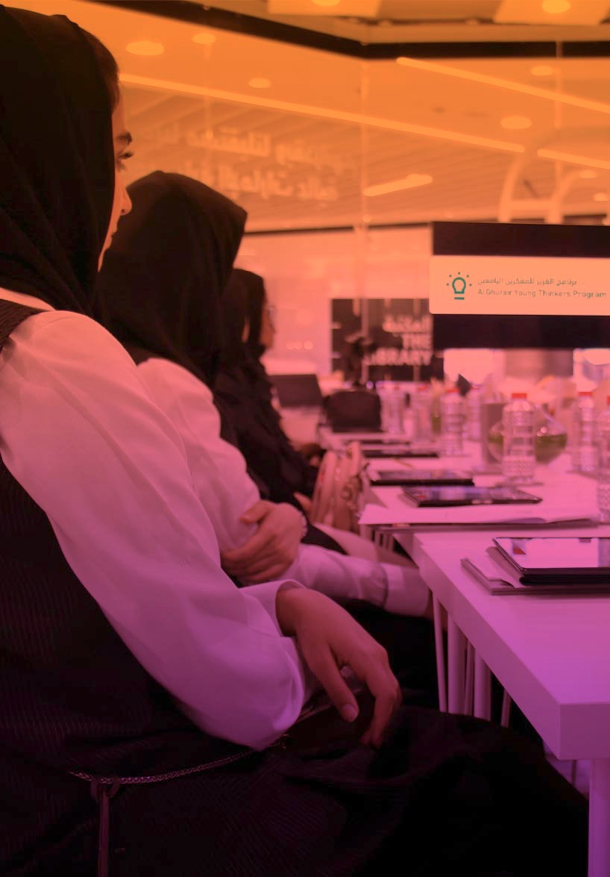
University and Career Preparedness of Arab Youth Case Study

Slide 14
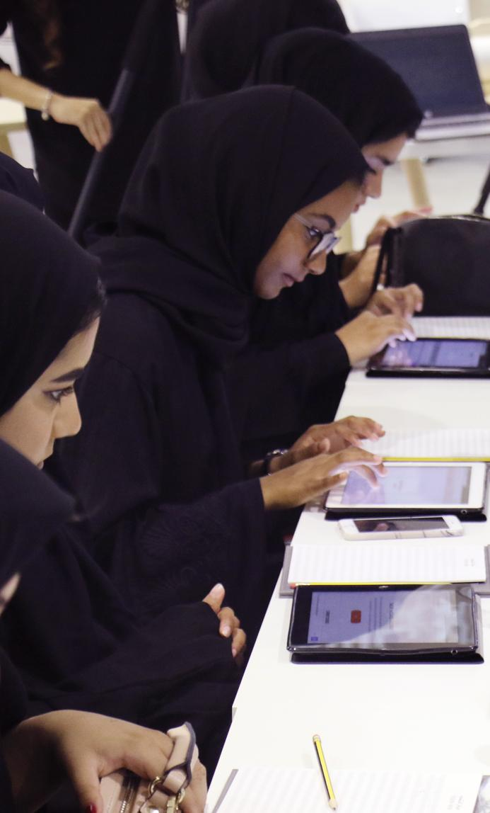
Education in the Arab World
Access: The Arab region has the world largest youth population.
Excellence: However, none of the region’s universities rank in world’s top 100.
Impact: In the UAE, 1/3 of the higher education budget goes towards preparing high school graduates who are unprepared to do college work.

Slide 15
Vision
A university and career readiness program to help Arab youth achieve success with:
Regionalized Career Exploration Tool (me3)
On Demand, Scalable Development in Soft Skills
Trained Success Advisors

Slide 16
Barriers to Engagement
English competency
Cultural contexts
Parents desires and concerns
Notes:
Conservatism limits what parents will allow their kids to participate in
Parents often drive the conversation of career opportunities limiting youth’s ability to discover themselves

Slide 17
Primary Motivators
Fun, Purpose-driven exploration
Easy, on-demand, incentivized skill development
Personalized, high-quality University and Career Advising

Slide 18
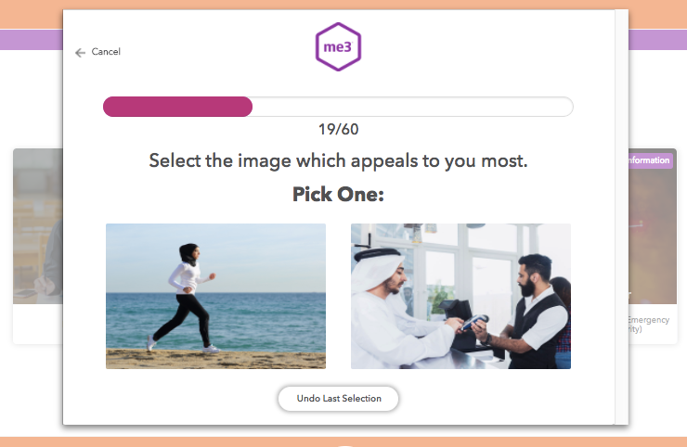
me3 Career Exploration Tool
me3 is an interactive image-based tool that matches Young Thinkers’ interests and passions to career paths.
Notes:
Regional needs/challenges:
Not enough qualified university graduates in specific professions need to power economic growth (STEM, etc)
Career guidance for youth
Student needs:
More college/career guidance and help with transitions
Motivation toward setting ambitious career goals and a path toward achieving them
How YTP bridges the two:
Initiates conversations around potential careers and gets student thinking strategically about college/degree choices

Slide 19
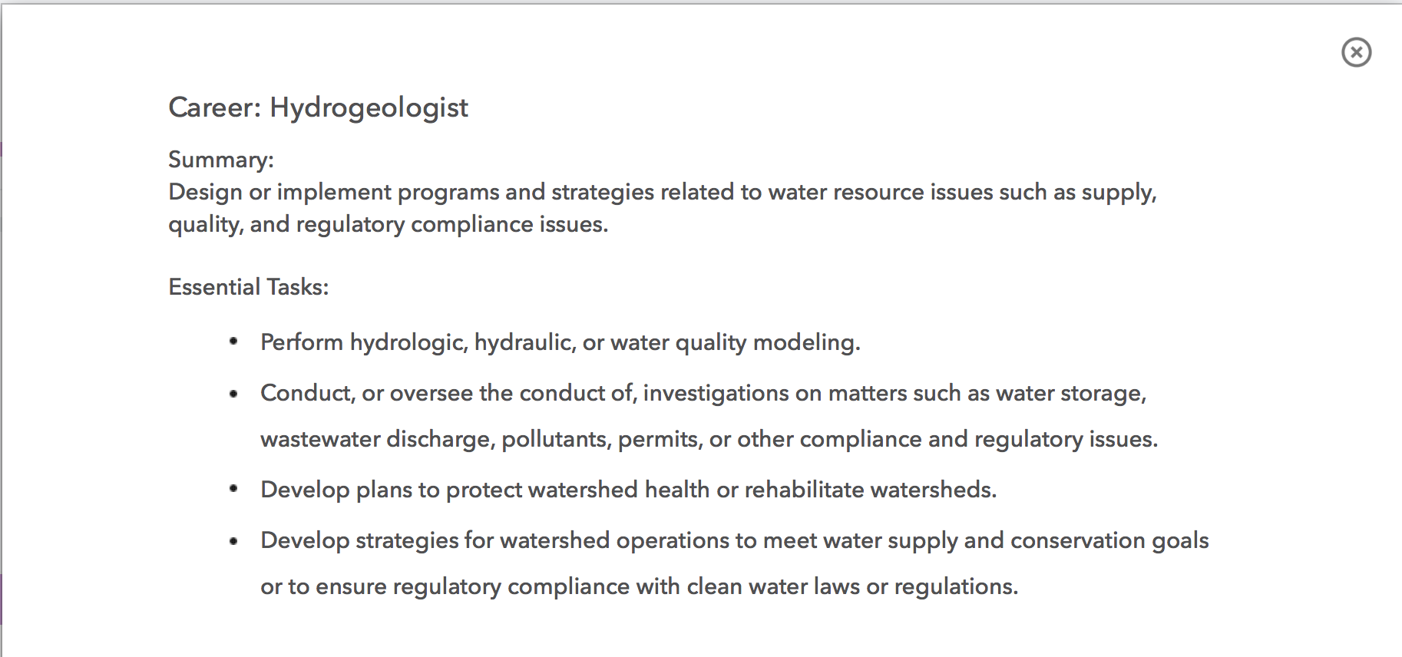
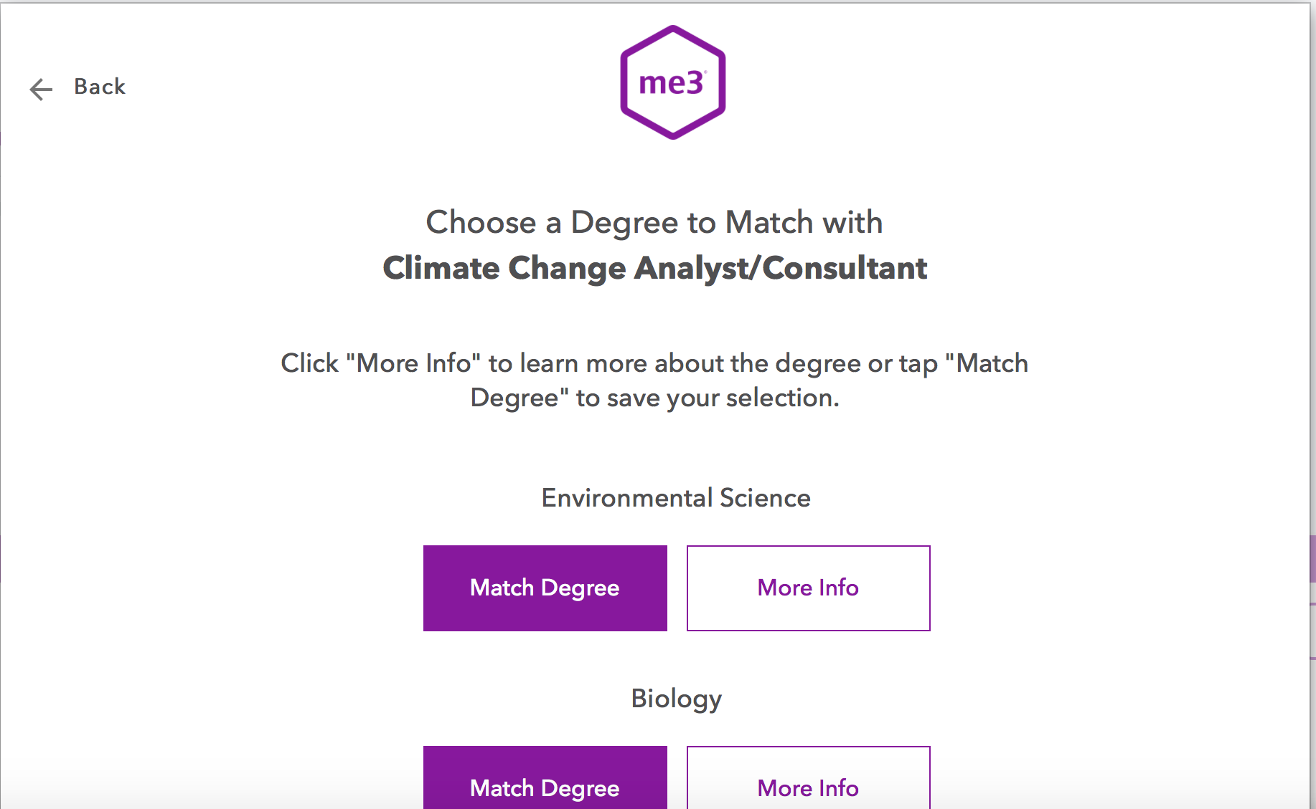
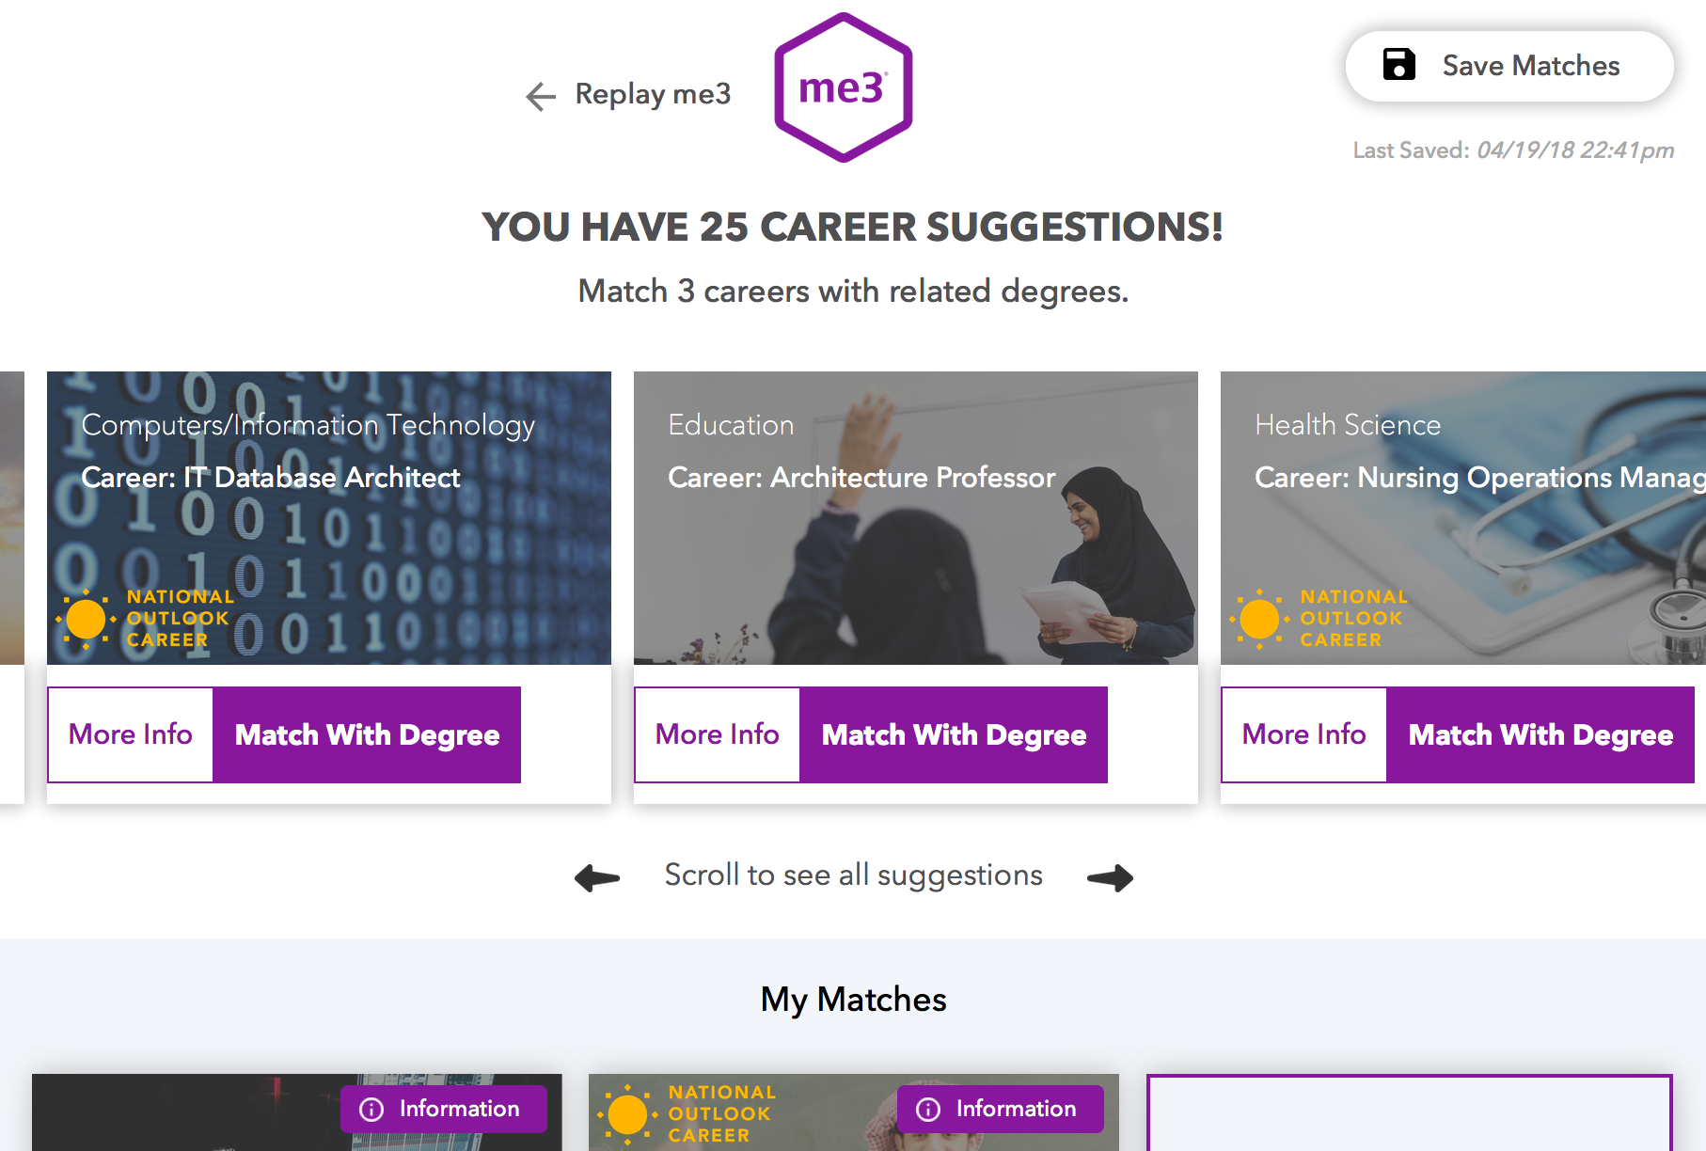
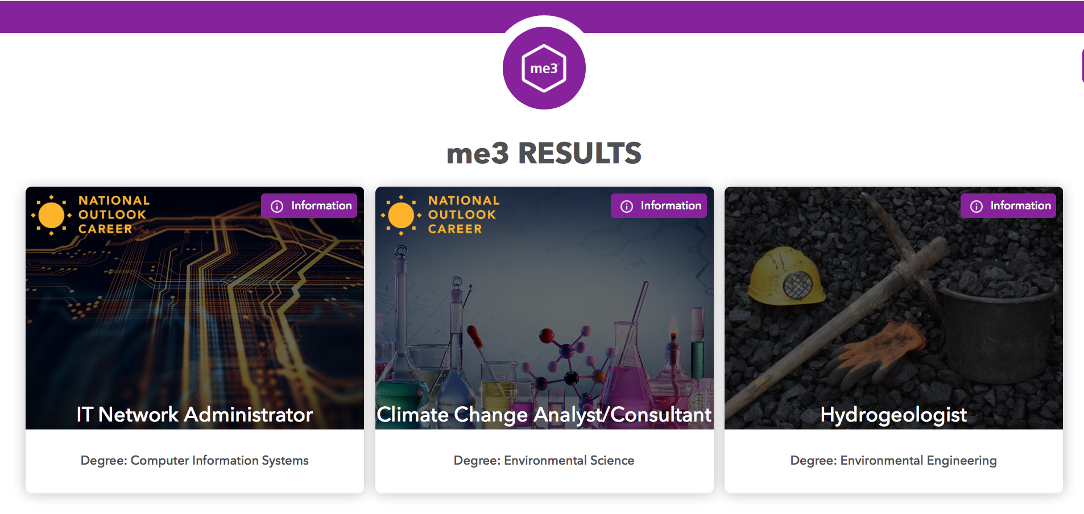
me3 Career Exploration Tool

Slide 20
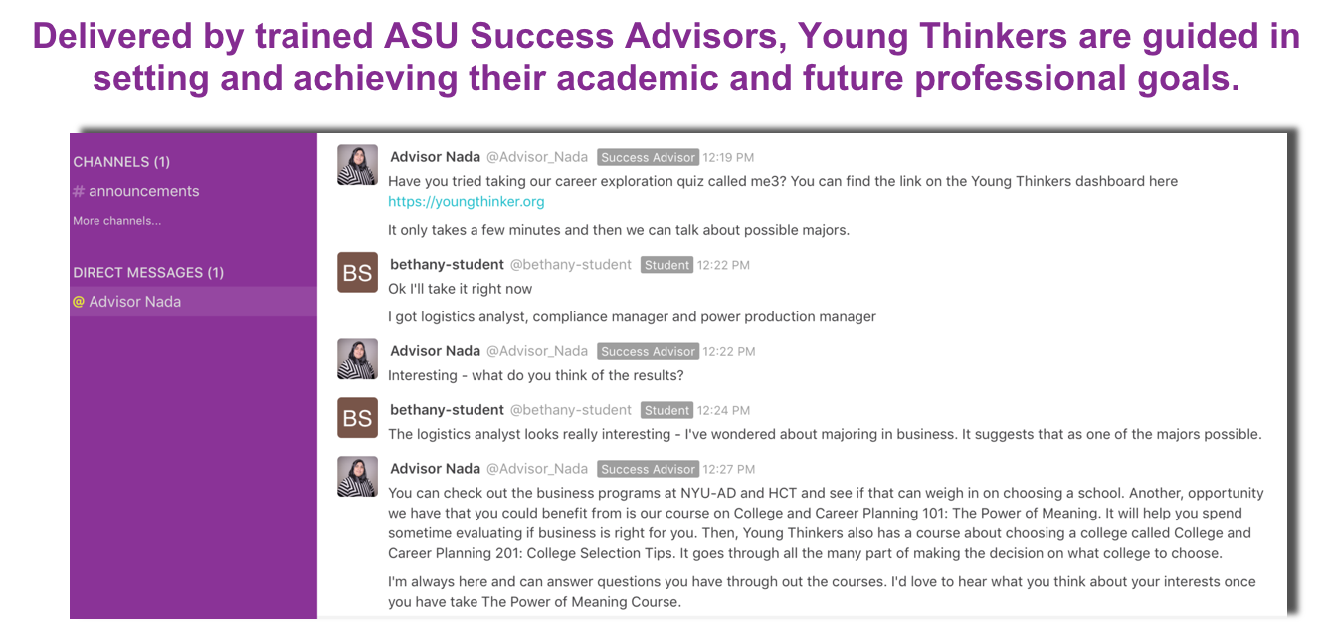
YTP Dashboard - Live Advising
Notes:
gender segregated - advisors from the region

Slide 21
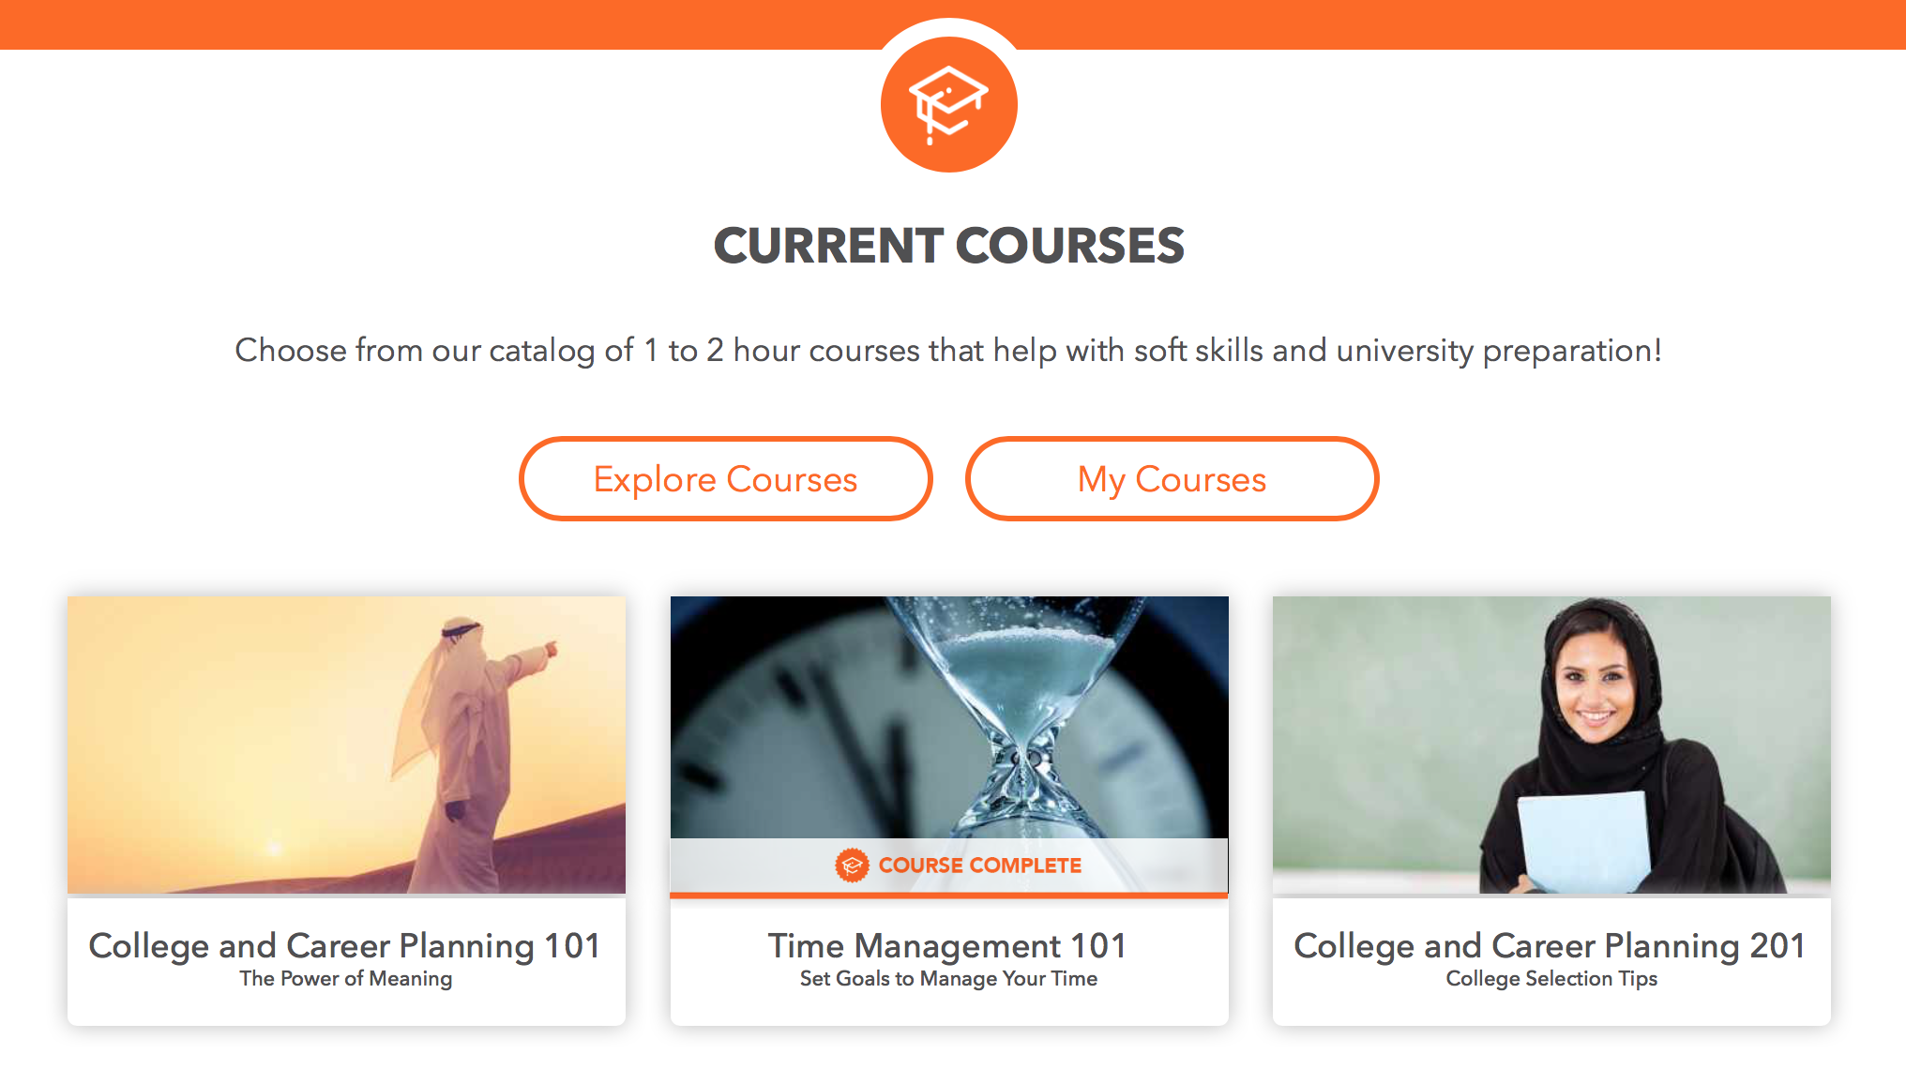
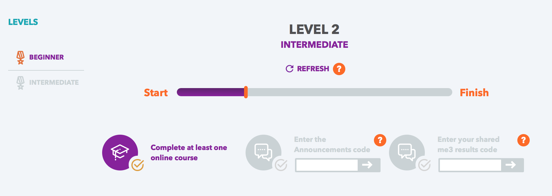
YTP Courses and Progress
Tailored coursework trains Young Thinkers in the soft skills they require for future success.
The gamified progress bar engages Young Thinkers in all aspects of the YTP Dashboard.

Slide 22
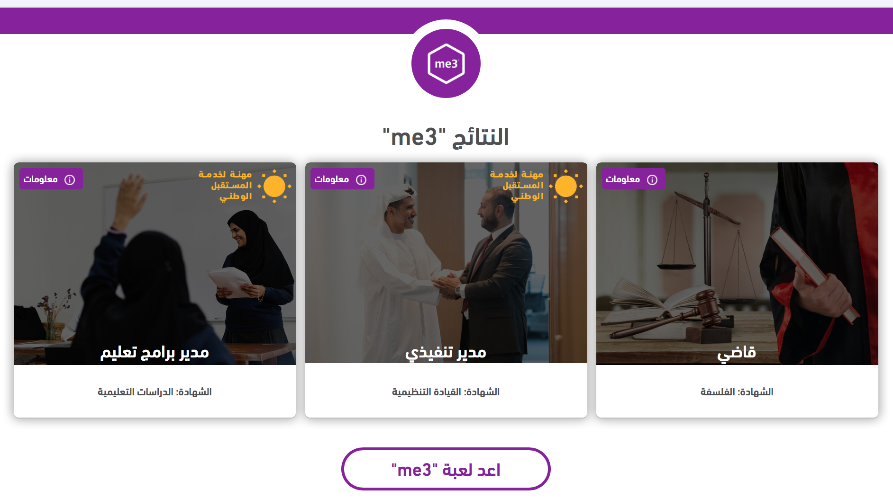
Dual Language Design

Slide 23
Application
When you picture your user base, who is excluded? If the used your product, what would their experience be like?
Whose perspective is missing from product development?
How might cultural habits change how your product is used? And how might your products change cultural habits?
What social norms, etiquette, or traditions could change because of your product?
Notes:
But these are just stories of two projects - so I leave you with these questions to think of

