Slide 1
Dream, Do, Drive
Emerge: ASU IT Professional Community Day.

Slide 2

UTO Mission.
The University Technology Office embraces its role as both an enabler and catalyst for advancing the vision and work of the New American University. We are a values-driven organization. Our commitments are reflected in all the work we do in pursuit of operational excellence, the experience and delight of our community, and our strategic and innovative initiatives.

Slide 4



A simple maturity model.
1 | Digitize
2 | Personalize
3 | Automate
4 | Integrate
5 | Redesign
6 | Optimize
7 | Analytics

Slide 6
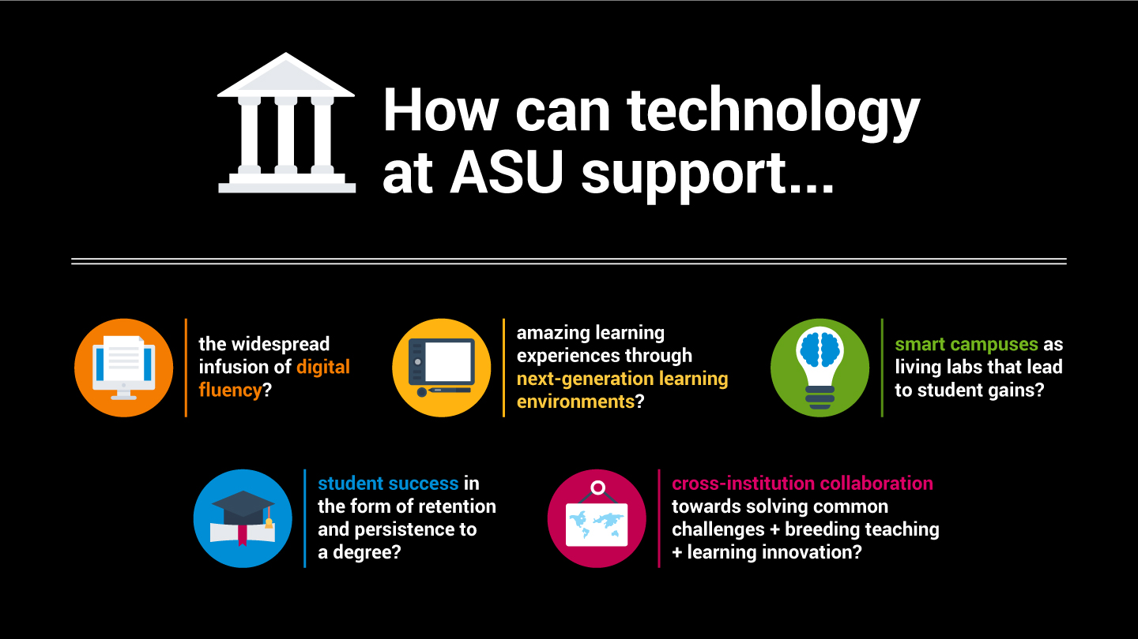

Slide 12

Living the Dream
View Video Online

Slide 13

Questions.

